Slide 1
Bios 7xx: Deep Learning Methods for Biomedical Applications with Pytorch
Chapter 1. Introduction to Deep Learning, PyTorch & Basic Algorithms
Notes:
It is my pleasure to be here presenting our research on dietary intake data. The goal of the study is to understand the association between cognition and temperament with nutrients and dietary patterns.

Slide 2
Content
1 Introduction to Diffusion models
2 Introduction to PyTorch
3 Introduction to UNC Research Computing Resources
4 Introduction to Basic Algorithm
Notes:
My presentation will include the following points.

Slide 3
Content
1 Introduction to Deep Learning
2 Introduction to PyTorch
3 Introduction to UNC Research Computing Resources
4 Introduction to Basic Algorithm
Notes:
My presentation will include the following points.

Slide 4
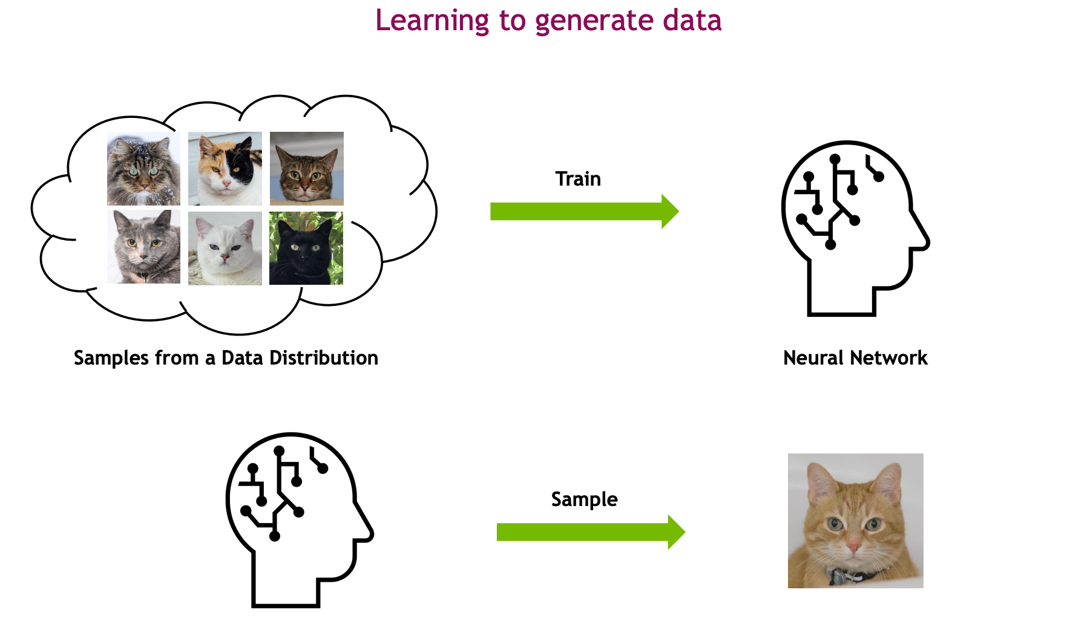
What is diffusion model? –generative model

Slide 5
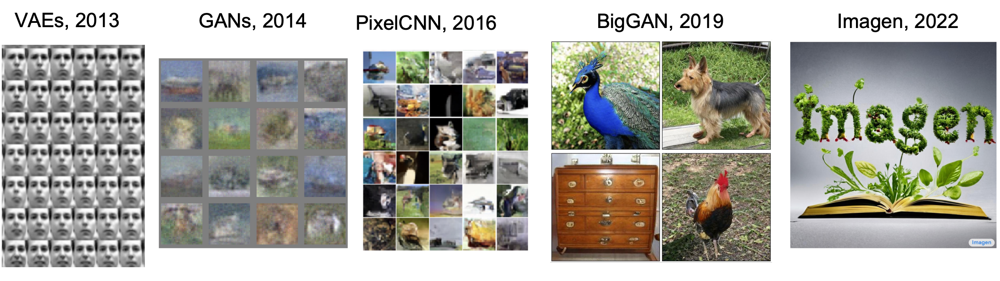
The history of generative models
VAE->GAN->Diffusion

Slide 6
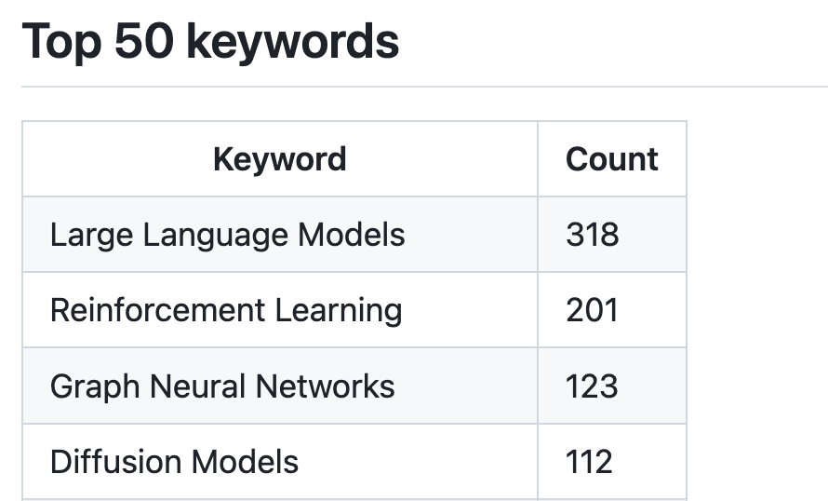
Key words of 2024 ICLR
Sidenote: Top3 conferences in AI are NeurIPS, ICML and ICLR.

Slide 7
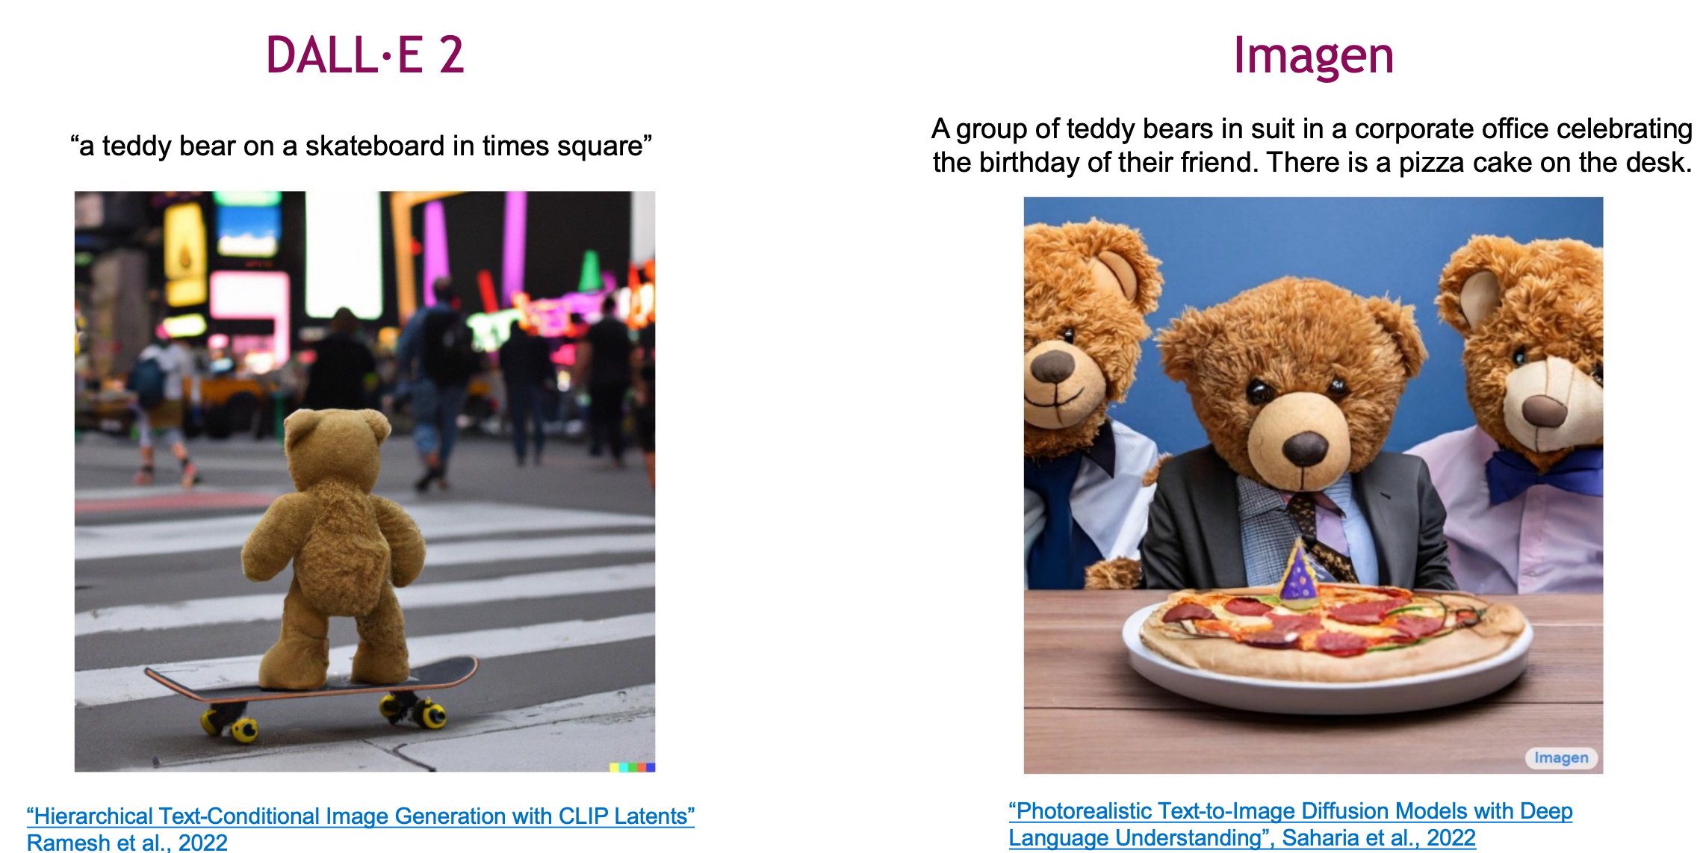
What can diffusion model do? (text to image)

Slide 8
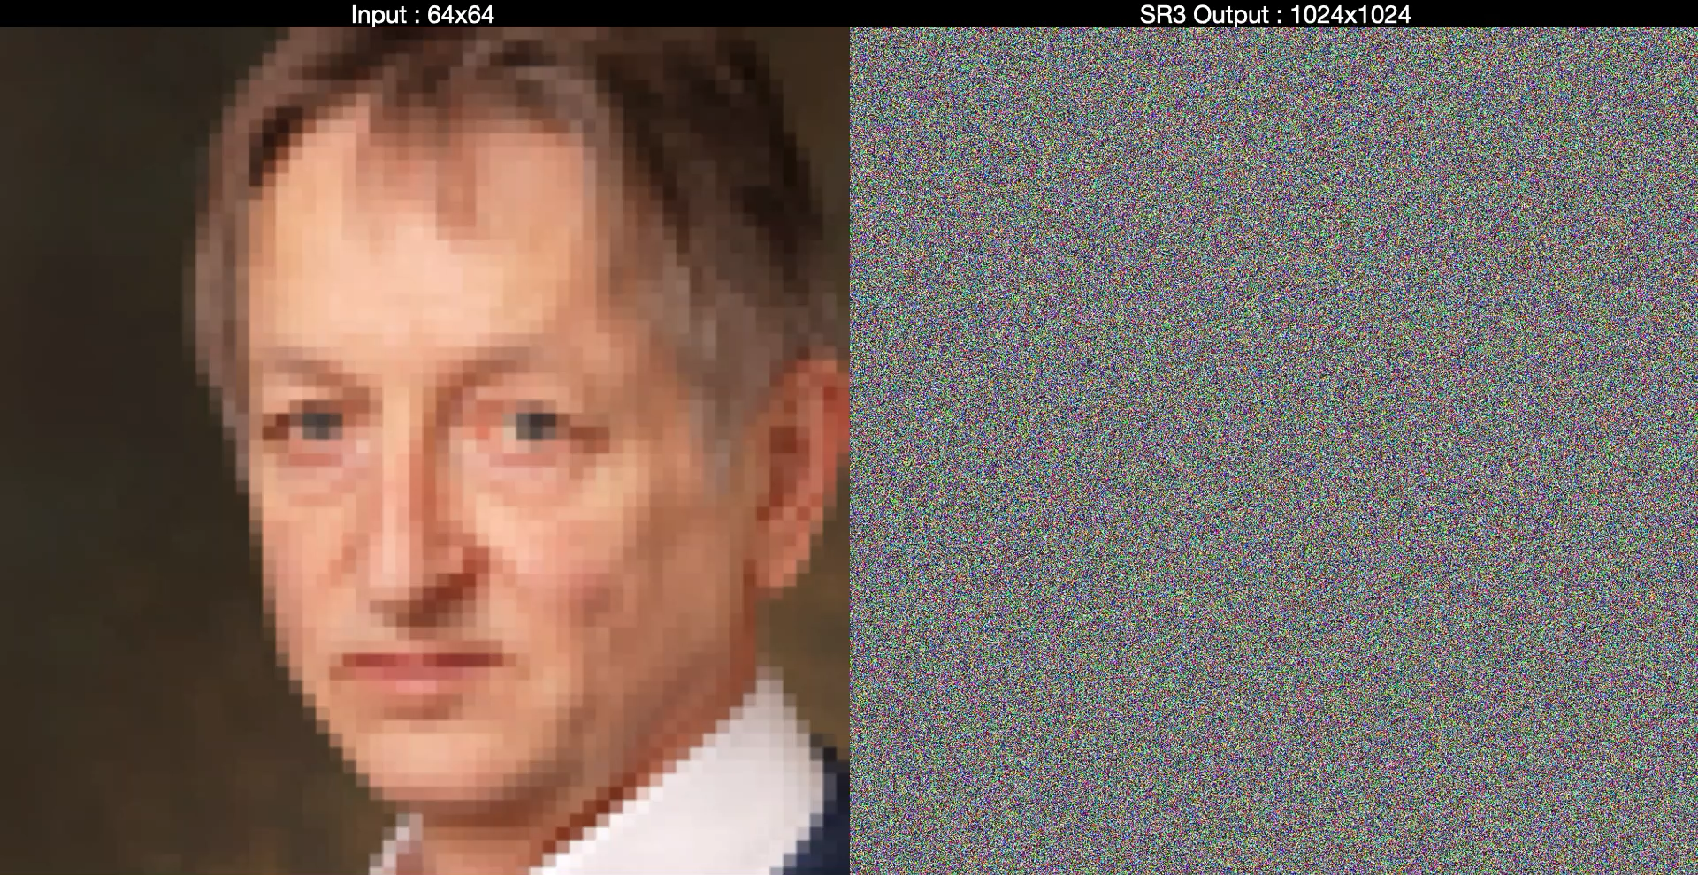
What can diffusion models do? (image resolution)

Slide 9
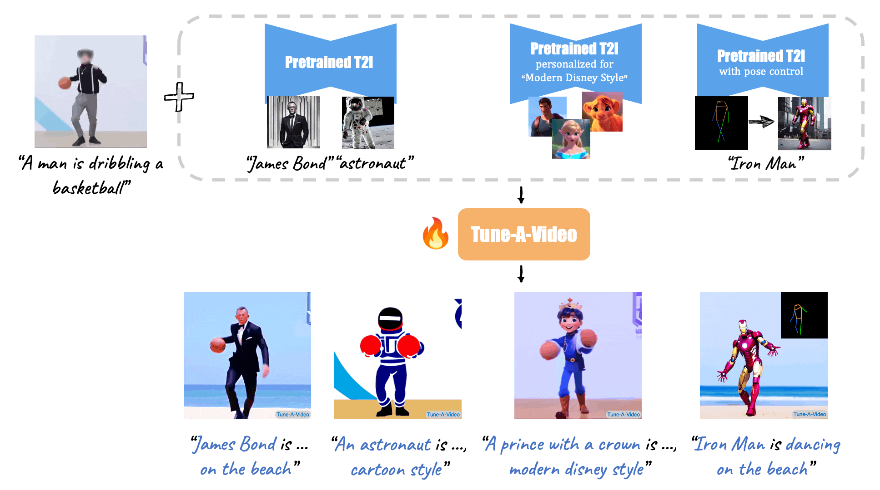
What can diffusion models do? (video generation)

Slide 10
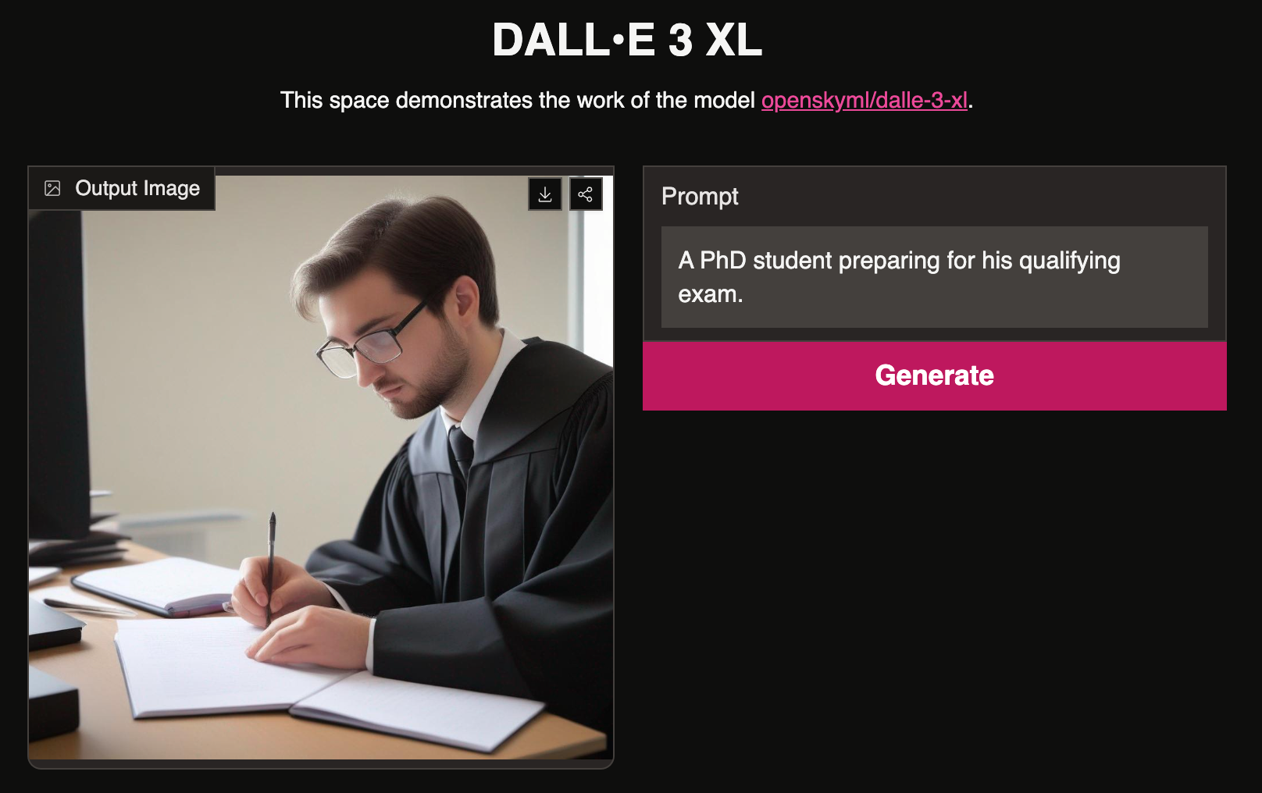

What can diffusion model do? (try yourself)
Many diffusion models spaces in huggingface, try them yourself!

Slide 11
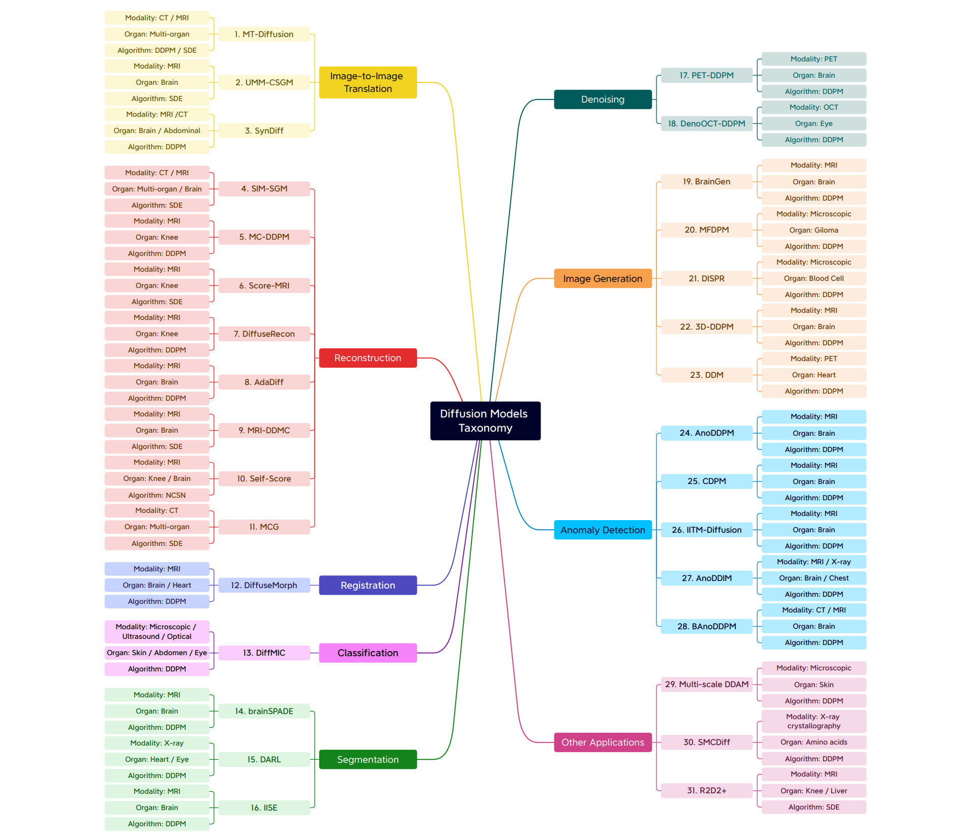
What can diffusion do in bio research?
https://arxiv.org/abs/2211.07804

Slide 12
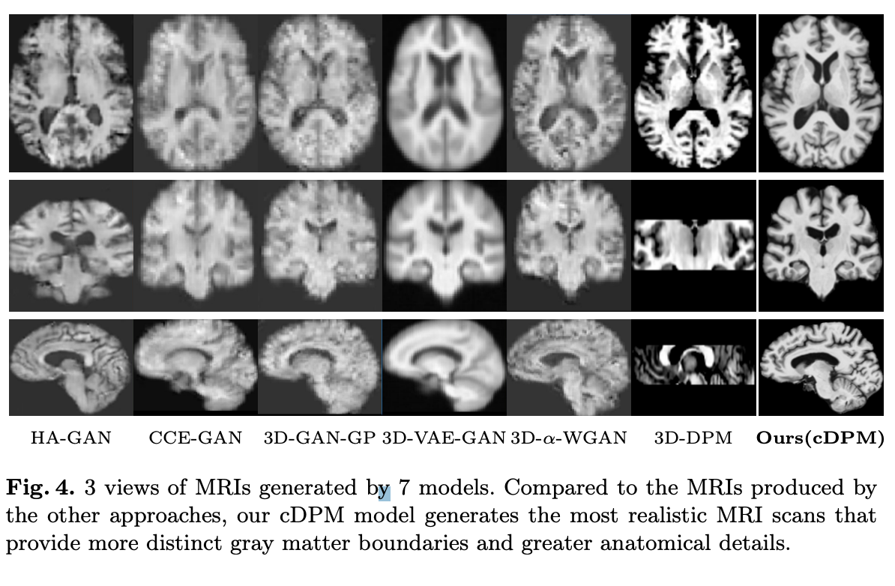
MRI Image generation

Slide 13
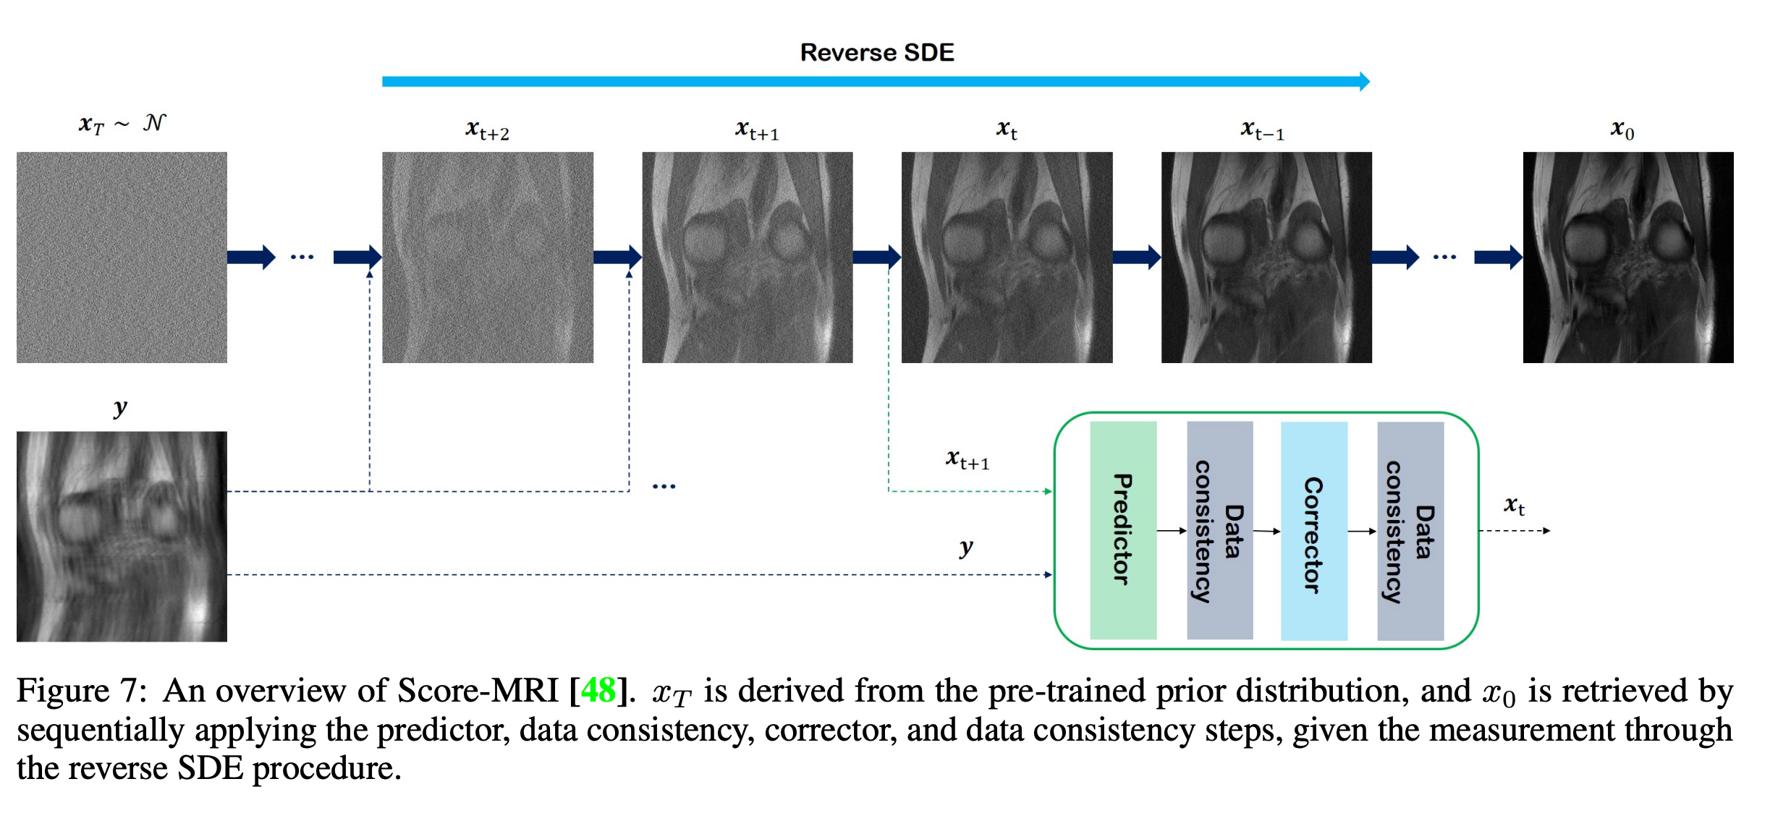
MRI image reconstruction

Slide 14
Content
1 Introduction to Deep Learning
2 Discrete time diffusion models
3 Continues time diffusion models
4 Introduction to Basic Algorithm
Notes:
My presentation will include the following points.

Slide 15
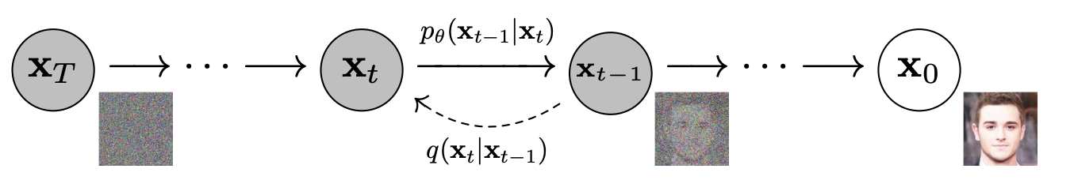
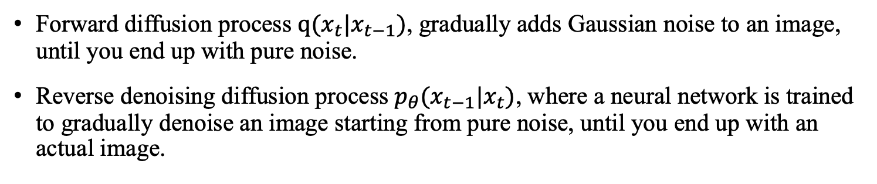
Discrete time diffusion models
Overview of diffusion models
Forward diffusion process $q(x_{t}|x_{t−1})$, gradually adds Gaussian noise to an image, until you end up with pure noise.
Reverse denoising diffusion process $p_{θ}(x_{t−1}|x_{t})$, where a neural network is trained to gradually denoise an image starting from pure noise, until you end up with an actual image.

Slide 16
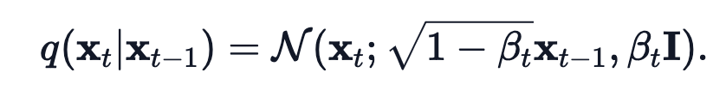
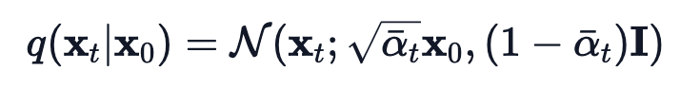
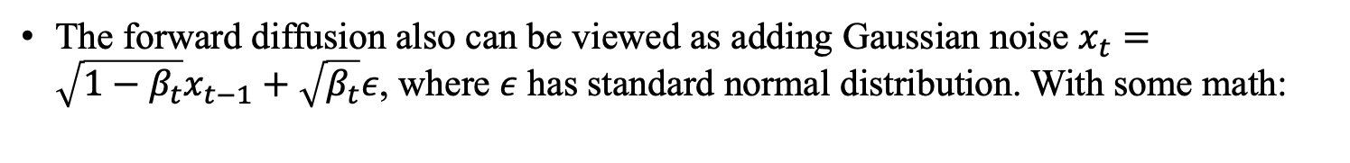
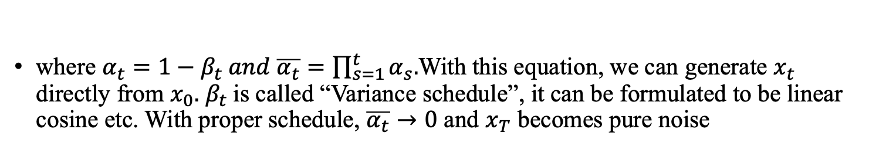
Forward Process
We define the forward conditional distribution to be Gaussian
The forward diffusion also can be viewed as adding Gaussian noise $x_{t}={\sqrt{1−β_{t}}x}_{t−1}+\sqrt{β_{t}}ε$, where $ε$ has standard normal distribution. With some math:
where $α_{t}=1−β_{t} and \overline{α_{t}}=\prod_{s=1}^{t}{α_{s}.}$With this equation, we can generate $x_{t}$ directly from $x_{0}.$ $β_{t}$is called “Variance schedule”, it can be formulated to be linear cosine etc. With proper schedule, $\overline{α_{t}}→0$ and $x_{T}$ becomes pure noise

Slide 17
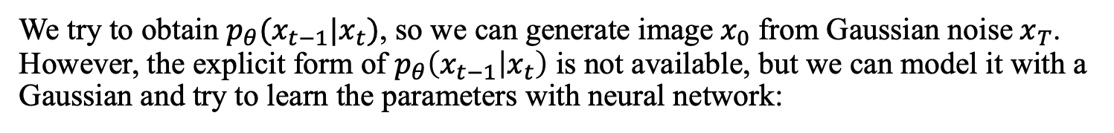
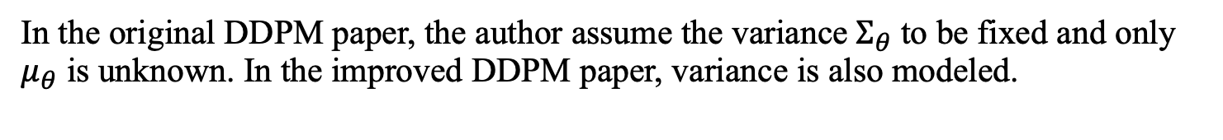
Backward Process
We try to obtain $p_{θ}(x_{t−1}|x_{t})$, so we can generate image$x_{0}$ from Gaussian noise$x_{T}$. However, the explicit form of $p_{θ}\left(x_{t−1} | x_{t}\right)$ is not available, but we can model it with a Gaussian and try to learn the parameters with neural network:
In the original DDPM paper, the author assume the variance${ Σ}_{θ}$ to be fixed and only $μ_{θ}$ is unknown. In the improved DDPM paper, variance is also modeled.
How to learn the parameters?

Slide 18
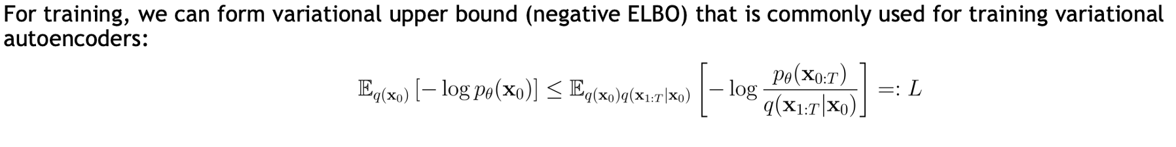
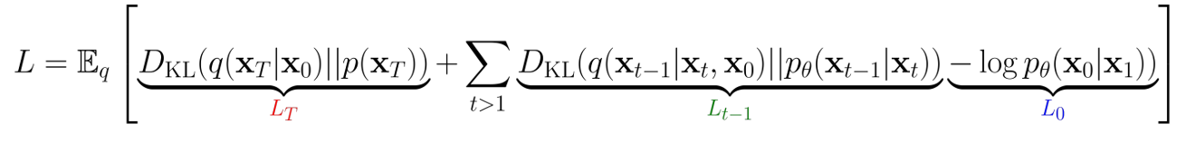
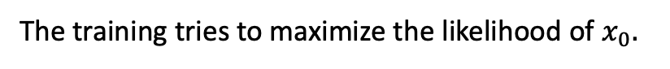
Model training
The training tries to maximize the likelihood of $x_{0}.$
(Minimize the loss by minimizing its upper bound.)
In the DDPM paper, them make the following decomposition:
$L_{T}$: Constant term because no learnable parameter in $q$.
$L_{0}$: Reconstruction term. It transforms continues embedding to image. May refer to the DDPM paper or github for details.

Slide 19
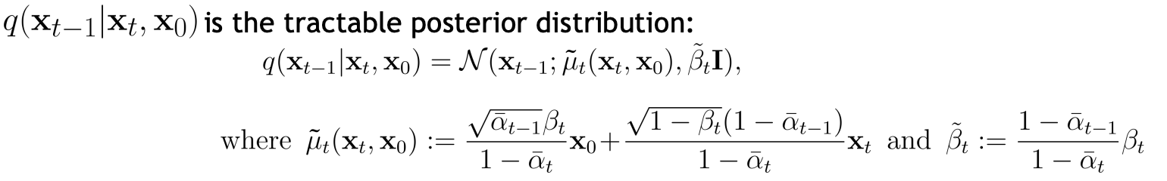
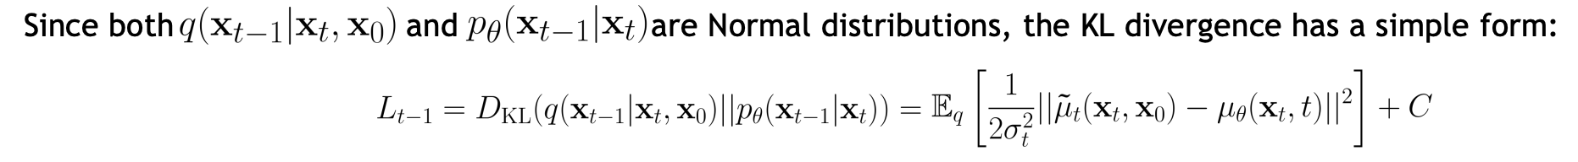
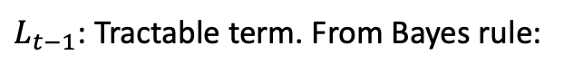
Model training
$L_{t−1}$: Tractable term. From Bayes rule:
Recall that we use Gaussian with learnable mean to model the backward process:

Slide 20
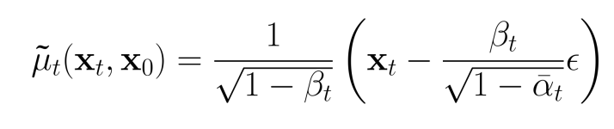
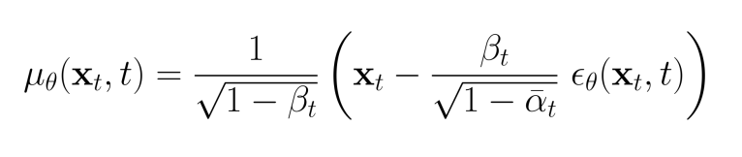
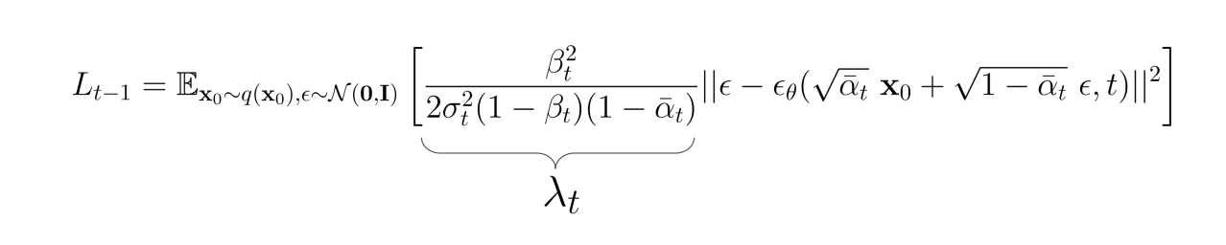

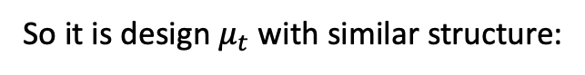
Model training
With some calculations, we can show:
So it is design $μ_{t}$ with similar structure:
Which leads to:
They let $λ_{t}=1$ in the DDPM paper

Slide 21
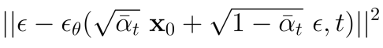
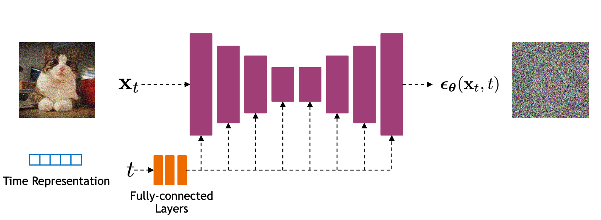
Model training
So the loss minimization degenerate to noise prediction task, which is minimizing the noise prediction MSE:
In practice, they use Unet with time encoding to construct $ε$.

Slide 22
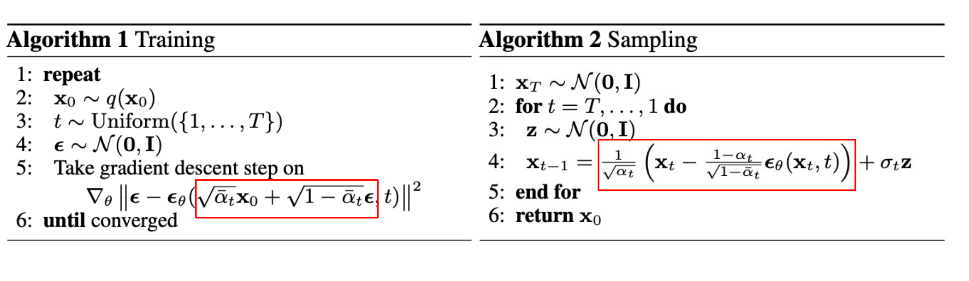
Summarize
First apply the Training algorithm to train $ε$ network, then use the Sampling algorithm to generate samples.

Slide 23
Speed up Diffusion Model Sampling
It is very slow to generate a sample from DDPM by following the Markov chain of the reverse diffusion process, as T can be up to one or a few thousand steps.
For example, it takes around 20 hours to sample 50k images of size 32 × 32 from a DDPM, but less than a minute to do so from a GAN on an Nvidia 2080 Ti GPU.
You may try it yourself in HW

Slide 24
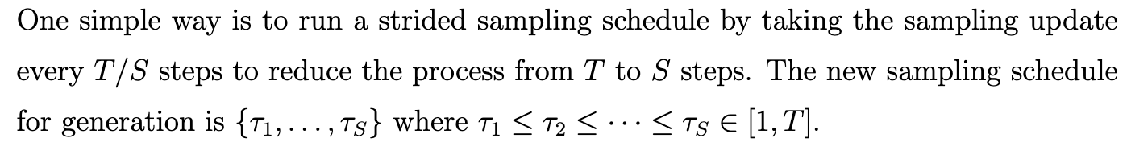
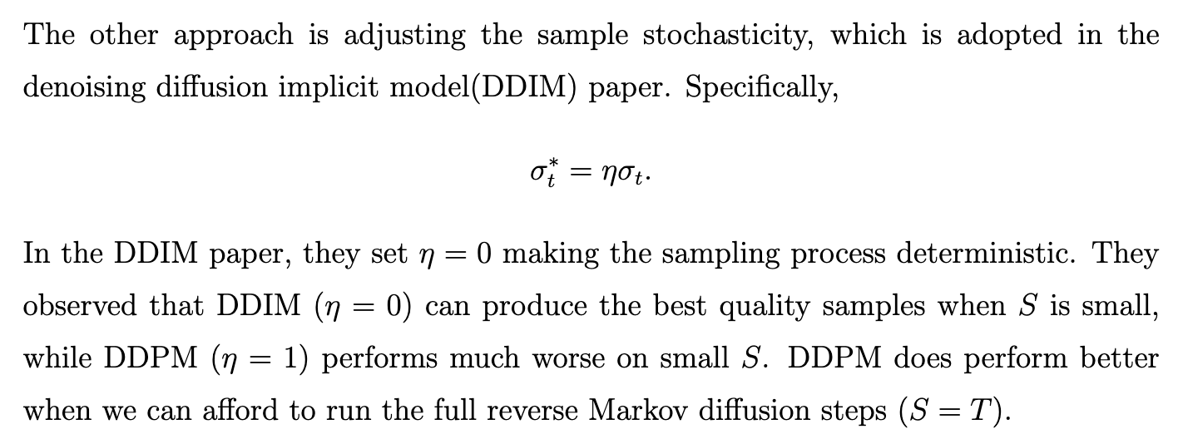
Speed up Diffusion Model Sampling
Can be founded in improved DDPM paper
You will try DDIM yourself in HW

Slide 25
References
Denoising Diffusion Probabilistic Models (DDPM) paper https://arxiv.org/abs/2006.11239
Improved Denoising Diffusion Probabilistic Models paper https://arxiv.org/abs/2102.09672
Denoising Diffusion Implicit Models (DDIMs) paper https://arxiv.org/abs/2010.02502

Slide 26
Content
1 Introduction to Deep Learning
2 Discrete time diffusion models
3 Continues time diffusion models
4 Introduction to Basic Algorithm
Notes:
My presentation will include the following points.

Slide 27
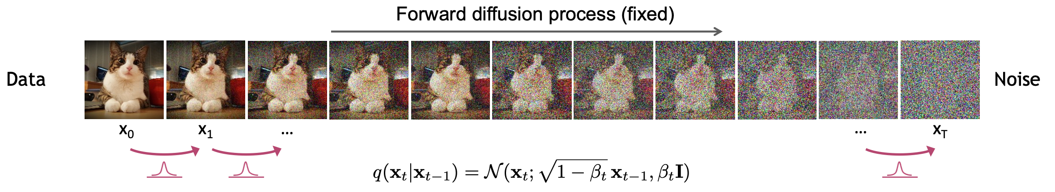
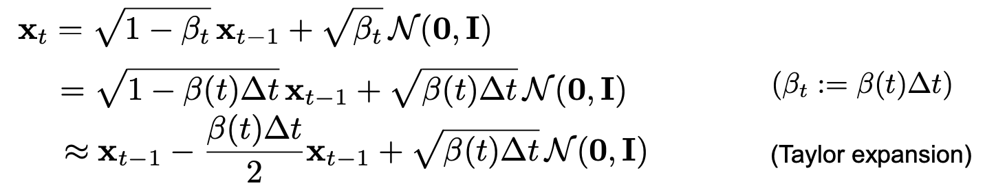
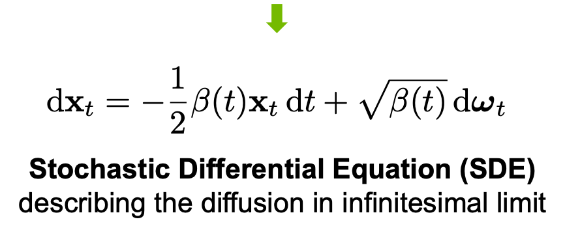
Continues time diffusion models
Consider when T is large, adding noise slowly.

Slide 28
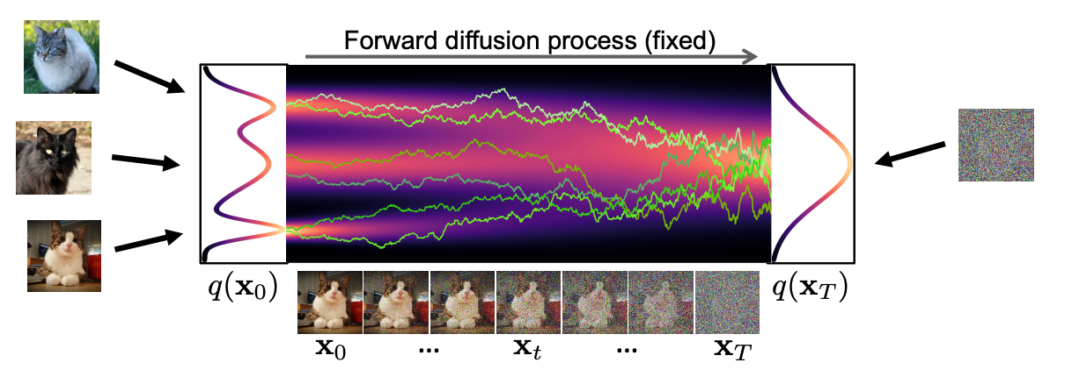
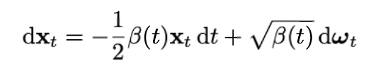
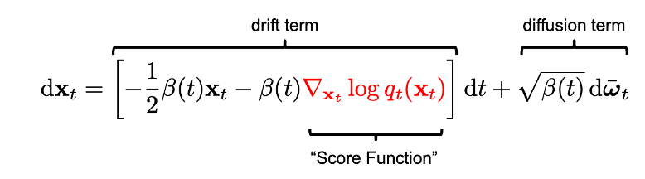
Continues time diffusion models
Forward process:
Can be derived using results from SDE. Omit the details.
Backward process:
How to get the score function?

Slide 29
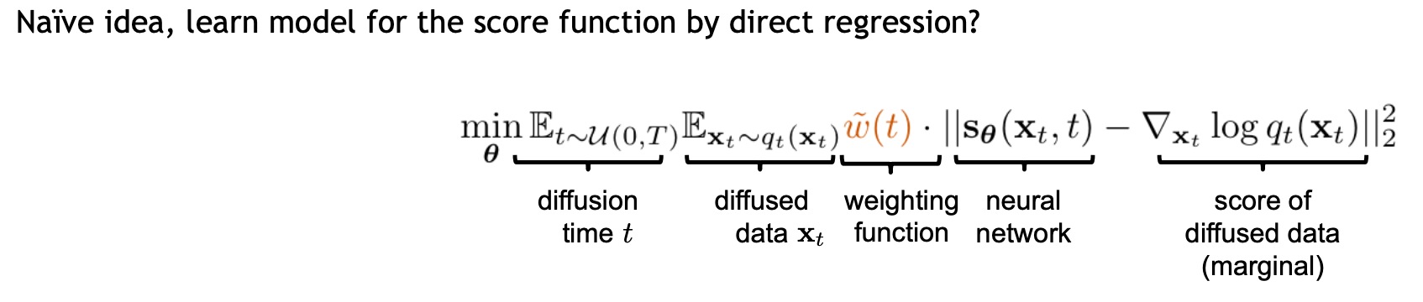
Continues time diffusion models
However, $q_{t}$ is not accessible. Otherwise set t=0 to generate${ x}_{0}$.

Slide 30
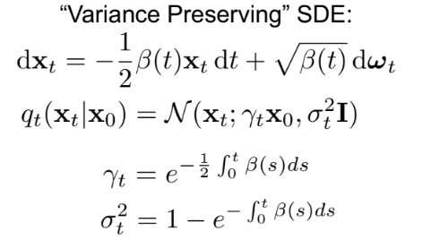
Continues time diffusion models
However, $q_{t}\left(x_{t} | x_{0}\right)$ is tractable:
Where the details can be find in appendix of (Song21)

Slide 31
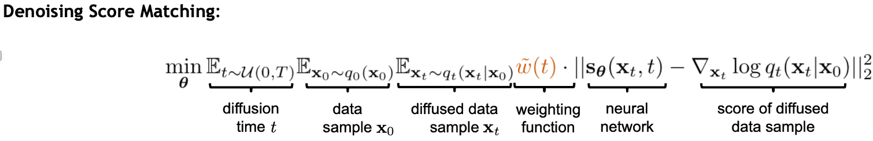
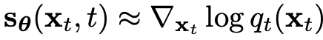
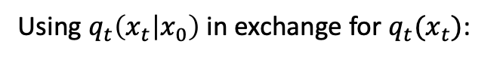
Continues time diffusion models
Using $q_{t}\left(x_{t} | x_{0}\right)$ in exchange for $q_{t}(x_{t})$:
Because we take expectation w.r.t ${ x}_{0}.$

Slide 32
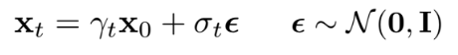
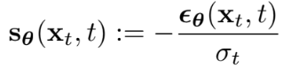
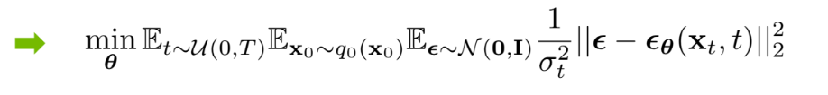
Implementing details – model design
Recall in DDPM, we figure out a the task is noise fitting. We will show similar results here.
So we can decompose the score function:
So we can design a model to prediction noise:

Slide 33
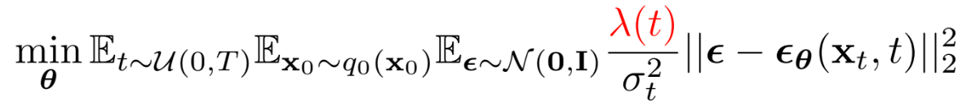
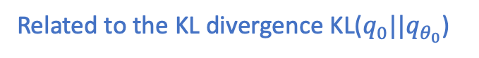
Implementing details – loss weighting
$λ(t)$ is the weight of the loss. Different loss weighing method trades off between perceptual quality and high likelihood.
If we set $λ\left(t\right)=β\left(t\right)$, we can get maximum log-likelihood.
Related to the KL divergence KL($q_{0}||q_{θ_{0}}$)
If we set $λ\left(t\right)={σ_{t}}^{2}$, we can get best perceptual quality.

Slide 34
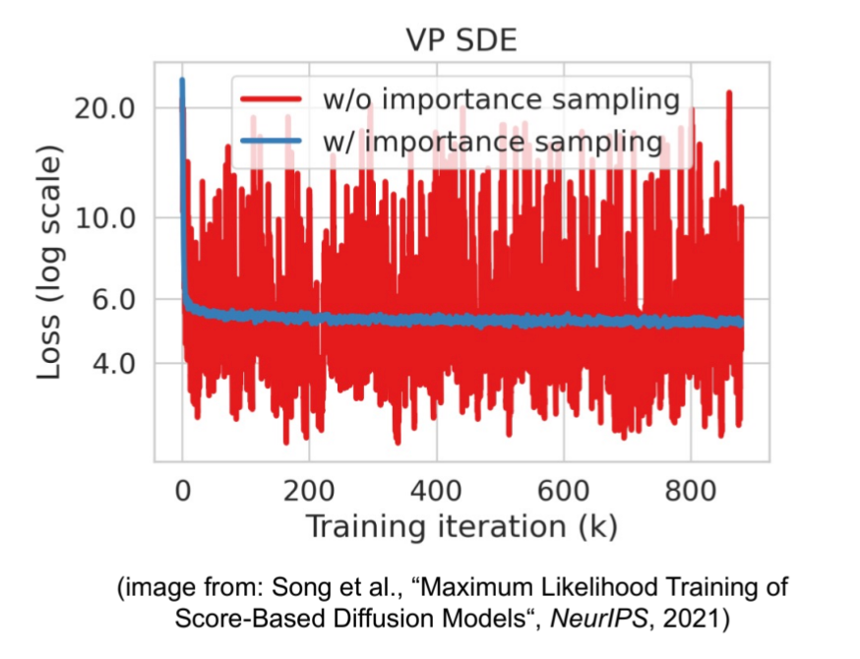



Implementing details – Variance Reduction
cut-off method:
Similar to gradient clipping but here we cut off small time-steps.
2. Importance sampling:
For detailed discussion, we refer the blog by Song.

Slide 35
Content
1 Introduction to Deep Learning
2 Discrete time diffusion models
3 Continues time diffusion models
4 Advanced research in diffusion models
Notes:
My presentation will include the following points.

Slide 36
Conditional diffusion models
The models we introduced before are all unconditional models. We have no control on the generating process and the contents we want. For example, the image trained using ImageNet can not generate cats specifically.
Unconditional models are often used to explore the capability of the generation model, to build a product usable for users, we have to make it able to follow instructions, which is the conditional diffusion model.
Conditional diffusion models can be generally classifies into two types, classifier guidance model and classifier free model. The classifier guidance model is budget friendly as it only requires a pretrained classifier and can be plug into the pretrained unconditional diffusion models by large companies. On the contrary, classifier free methods need to retrain the whole diffusion model but it can provided better performance and is adopted by large companies.

Slide 37

Conditional diffusion models

Slide 38

Conditional diffusion models – Classifier guidance
Suppose we have a classifier $p_{φ}(y|x_{t})$, which we can train by generating training data with the forward process(adding noise to $x_{0}$)
We can use that classifier to direct the diffusion model in generating an image corresponding to label y.

Slide 39





Conditional diffusion models – Classifier guidance
With bayes rule
Adding noise won’t affect classifying, $p_{φ}(y|x_{t−1})≈p_{φ}(y|x_{t−1},x_{t})$
Apply Taylor expansion
We know that
So we have

Slide 40



Conditional diffusion models – Classifier guidance
Rewriting the equation on previous page:
As for the unconditioned diffusion model:
Comparing these two, we can see that only the term
is added. In practice, we use the classifier
To classify the image $x_{t}$ generated by the diffusion model and calculate the probability of the target class y. Then we take gradient with respect to $x_{t}$ and use that to guide the backward sampling process.

Slide 41


Conditional diffusion models – Classifier free
As for classifier free model, just need to apply Bayes Theorem to substitute the classifier guidance part.
Then we can merge the
So we only need to implement one epsilon network and set y to zero with no label.

